Slide 1
Global Terrorism

Slide 2
Table of Contents
01
Problem Statement
05
02
Data Results
Background
06
03
Conclusion
Dataset
07
04
References
Methodology

Slide 3
01
Problem Statement
Addressing Escalating Global Terrorism Threats

Slide 4
Problem Statement
Global terrorism rapidly escalated worldwide between 1970 and 2017, as the number of terrorist incidents rose from 500 in 1970 to over 16,800 by 2017 (GTD, 2021). The lethality of attacks also increased substantially, with deaths from terrorism rising from under 500 in 1970 to over 26,400 in 2017 (GTD, 2021). Research underscores how globalization enabled the spread of terrorism by facilitating recruitment, financing, and information sharing amongst extremist groups (Li et al. 2004). At the same time, the religious underpinnings driving Islamist militant organizations came into focus as they conducted over 15,000 attacks between 1970-2017 (Jones et al. 2008). Expert analysis concludes that terror groups exploit fragile states, utilize increasingly lethal tactics, and tap into global networks to sustain escalating world-wide terrorism (Crenshaw, 2017). Consequently, counter-terror policies require coordinated responses targeting terror financing, extremist recruitment on digital platforms, as well as military interventions to effectively mitigate the rising global threat. This study will analyze global terrorism data from 1970-2017 to identify trends in the underlying drivers, tactics, impacts, and policy responses.

Slide 5
02
Background
Understanding Patterns and Drivers of Terrorism

Slide 6
Background
Overview of Rapid Surge in Worldwide Terrorism
Data shows terrorist attacks escalated from around 500 globally in 1970 to over 16,800 incidents by 2017 (GTD, 2021). Terror-linked deaths rose even more sharply in this period. Terror strikes also have larger destructive impacts now on lives as well as economies. Research is hence crucial to understand reasons for terrorism’s surge since the 1970s and formulate policies to control this.
Impacts of Global Terrorism
The GTD (2021) documents over 4.6 million people injured or killed directly from terrorist attacks just between 2002-2017. The economic impacts are likewise staggering, with global GDP declining by up to USD $53 billion annually and nations spending vast budgets on counter-terror interventions. Indirect psychological, political and social impacts also abound. Integrated policy responses covering key drivers are hence imperative.

Slide 7
Background
New Killing Tactics & Weapons Access Increasing Deaths
Gartenstein-Ross et al. (2016) reviewed how attack tactics evolved, especially amongst religious terror outfits gaining wider access to deadly materials. Groups like Hezbollah began using methods like coordinated bombings and hostage-takings for higher lethality. Their 1983 Lebanon barracks bombing killed over 300 people (p.73). Al Qaeda’s large-scale 9/11 attacks took this further, murdering around 3,000. ISIS pursues similar mass casualty tactics. In contrast, extreme right groups still mostly rely on targeted killings rather than indiscriminate violence (p.105). Free precursor chemical flows remain a top policy concern.
Online Spread of Extremism Enabling Global Reach
Berger et al. (2013) demonstrate using network analysis how digital media enabled accelerated spread of terror philosophies more widely across borders. Both physical terror cells and online extremist recruiting expanded exponentially since the 1990s.

Slide 8
Background
Terrorist ideologies justifying widespread religious violence and white supremacist hate speech now reach much wider, global audiences including impressionable youth. Unconstrained online extremism emerged as a key enabler for globally coordinated terror attacks and self-radicalization. Curbing online radicalization is vital.
Terror Groups Exploit Fragile Nations
Piazza (2008) identified state fragility as among the strongest predictors of terror group formation and durable activity (p.472). By exploiting state weaknesses like weak rule of law and poverty, groups like Taliban in Afghanistan, FARC in Colombia and Al Qaeda in Middle East thrived. Reducing deprivation and improving civil liberties are very effective to counter terror activity in fragile nations. Alongside military actions, addressing instability via socio-economic progress is crucial.

Slide 9
Background
In summary, global terrorism escalated since the 1970s due to – innovations enabling deadlier attacks, online radicalization reaching wider vulnerable populations globally, and persistent instability in fragile nations enabling terror groups to organize and thrive. Integrated policy responses covering all three drivers are imperative to mitigate this threat.

Slide 10
03
Dataset
Global Terrorism Database Analysis for Insightful Trends

Slide 11
Dataset
This proposal will examine data on terrorism attacks worldwide from 1970-2017 to understand key trends and form solutions.
The data comes from the Global Terrorism Database - the world's most complete open-source database tracking over 180,000 terrorist attacks globally from 1970-2017. This data is compiled by top terrorism researchers at the University of Maryland.
This rich dataset documents key facts on each individual terror attack, including:
Date & location of each attack
Perpetrator details - which terror organization was responsible
Exact attack tactics used - bombing, shooting, hostage-taking
Targets of each attack - civilians, government, infrastructure
Number of fatalities and injuries per attack
Extent of property damage
In essence, this data reveals the full story of 180,000+ terror attacks worldwide over nearly 50 years - providing incredible insights into evolving trends.

Slide 12
04
Methodology
Analytical Approach for Terrorism Analysis

Slide 13
Methodology
To analyze the data and identify trends in global terrorism, we will employ a quantitative approach utilizing descriptive and inferential statistical techniques. The methodology will involve several key steps:
Data Preparation: We will clean and preprocess the GTD dataset to ensure data quality and consistency. This may involve handling missing values, encoding categorical variables, and standardizing data formats.
Exploratory Data Analysis (EDA): We will conduct exploratory data analysis to gain insights into the distribution and characteristics of terrorist incidents worldwide. This will involve visualizations such as histograms, scatter plots, and heatmaps to identify patterns and correlations in the data.

Slide 14
Methodology
Trend Analysis: We will analyze temporal trends in global terrorism, examining changes in the frequency, lethality, and characteristics of terrorist incidents over the study period. This will involve time series analysis and trend visualization techniques to identify long-term patterns and anomalies.
Comparative Analysis: We will compare and contrast different regions, attack types, perpetrator groups, and target types to identify variations and commonalities in terrorist activities across geographic and socio-political contexts.
Policy Implications: Based on our analysis, we will provide insights and recommendations for policymakers to formulate evidence-based counterterrorism strategies. This will involve identifying priority areas for intervention and assessing the effectiveness of existing counterterrorism measures.

Slide 15
Methodology
By employing a rigorous methodology and leveraging the rich dataset provided by the GTD, this analysis seeks to contribute to a better understanding of global terrorism trends and inform evidence-based policy responses to mitigate this pressing global security challenge.

Slide 16
05
Data Results
Trends, Patterns, and Correlations in Global Terrorism Incidents

Slide 17
Preprocessing
The first step was loading the csv dataset into a pandas data frame (df) for analysis. An initial check of missing values was done to identify columns with excessive missing data. Columns with missing values were dropped.
Next, the data frame was checked for duplicate rows. No duplicate rows were found, but as a precaution, duplicate rows were dropped.
An additional check was done to ensure there were no missing target values in the “nkill” column, which indicates number of fatalities per incident. Rows without this critical attack information were dropped.

Slide 18
Some Basic Analysis
Country with Highest Terrorist Attacks: Iraq
Regions with Highest Terrorist Attacks: Middle East & North Africa
Maximum people killed in an attack are: 1570.0 that took place in Iraq
Year with the most attacks: 2014
Month with the most attacks: 5
Most Attack Types: Bombing/Explosion

Slide 19
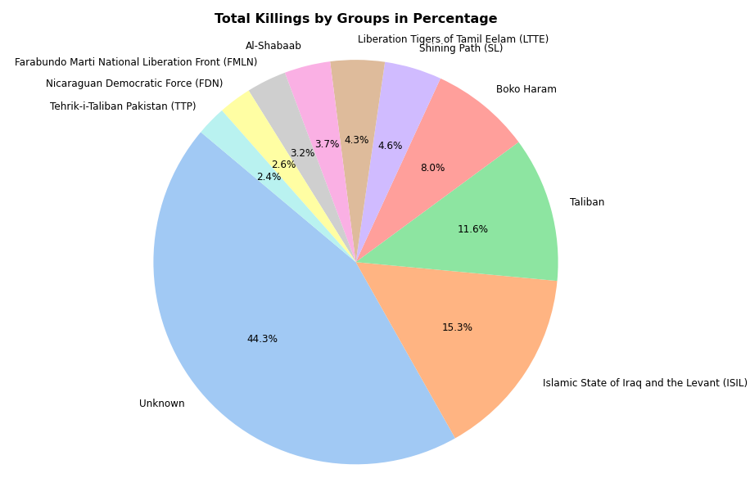
Terrorist Groups With Most Attacks
The total percentage killings by Unknown groups were highest, 44.3%. Followed by, ISIL at 15.3% and Taliban at 11.6%.

Slide 20
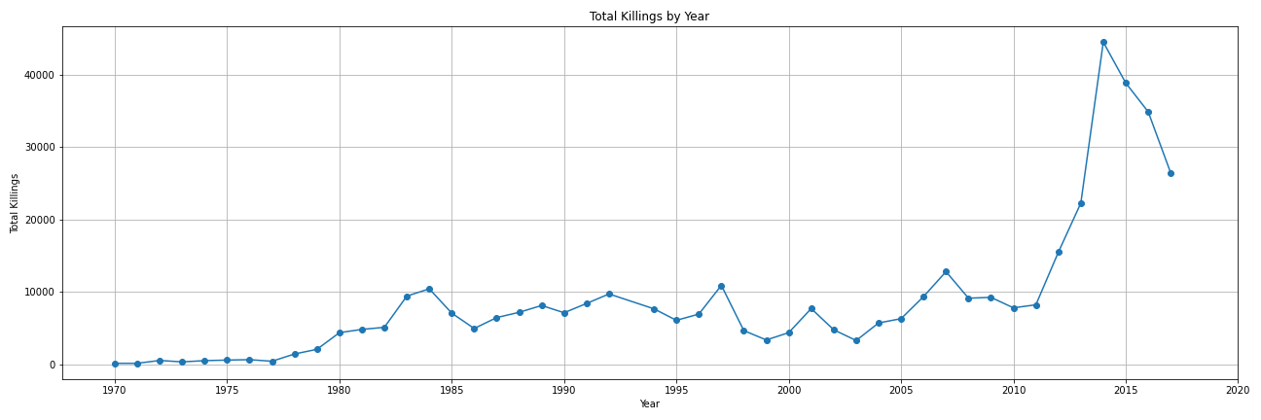
Attacks By Year
We can observe that number of killings by terrorist attack reaches it's peak in the year 2014 and then starts to decrease.

Slide 21
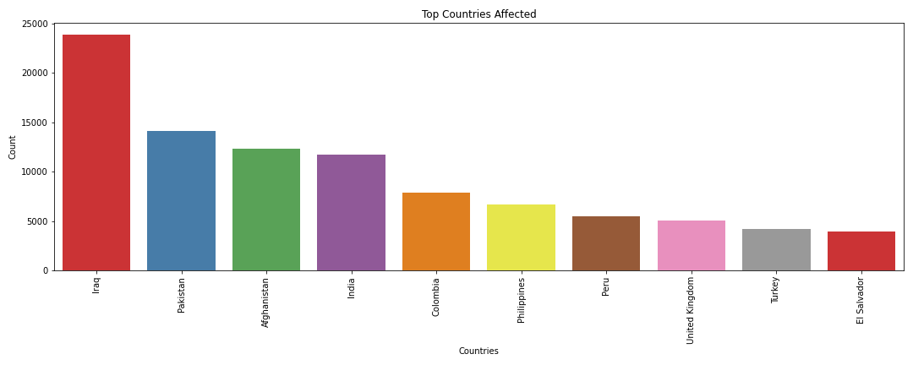
Countries With Highest Terrorist Attacks
The highest terrorist attacks were committed in Iraq with 24636 attacks The other 4 countries with highest terrorist attacks are:
2. Pakistan with 14368 attacks
3. Afghanistan with 12731 attacks
4. India with 11960 attacks
5. Colombia with 8306 attacks
6. Philippines with 6908 attacks
7. Peru with 6096 attacks
8. United Kingdom with 5320 attacks
9. Turkey with 5235 attacks
10. El Salvador with 4292 attacks

Slide 22
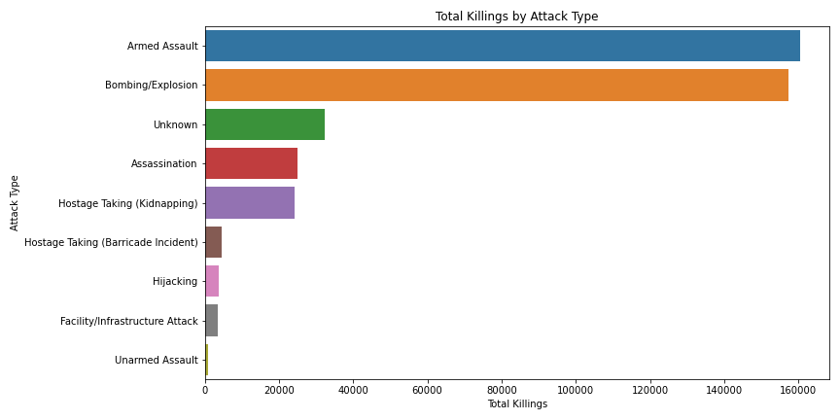
Attacks By Attack Type
Most number of killings were due to Armed Assault and Bombing/Explosion.

Slide 23
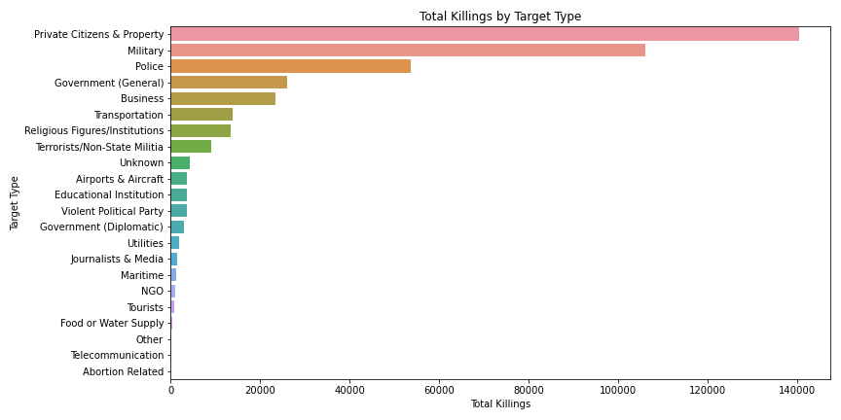
Attacks By Target Type
Majority of the deaths were observed when the target was citizens of the country, specific property, military or the police.

Slide 24
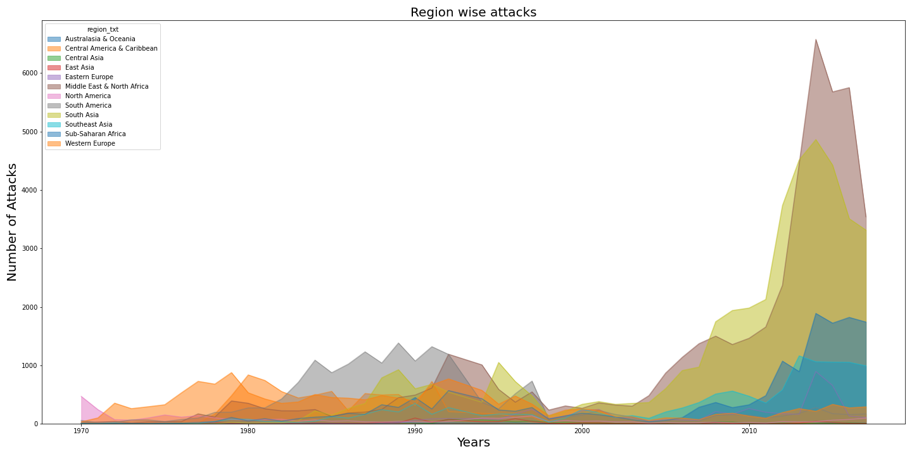
Attacks By Region Wise
Middle East & North African region and the South Asian region have faced the most number of killings compared to any other region.

Slide 25
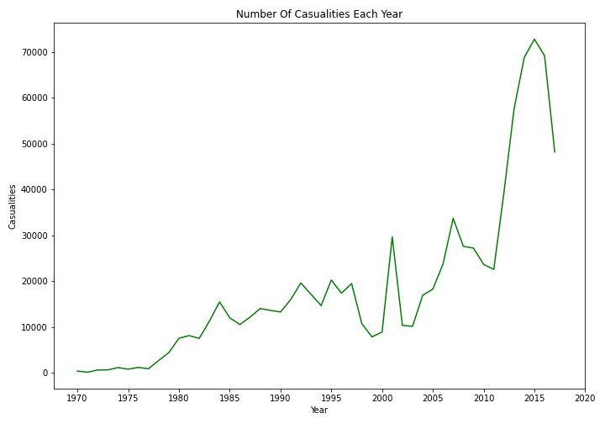
Number of Causalities Each Year

Slide 26
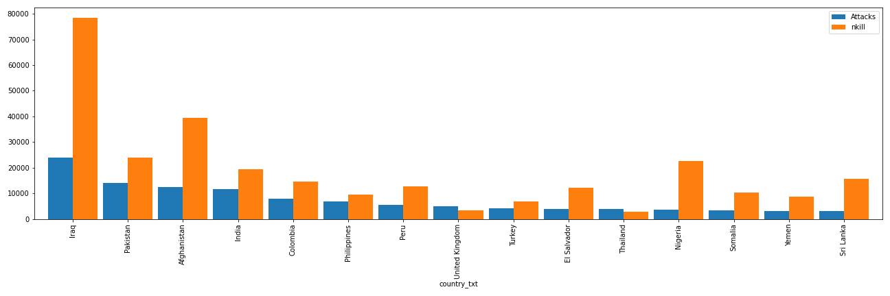
Attacks Vs Killed
The number of killed is almost 3 folds more than attacks for Iraq. Thus, the densely populated theory holds good.

Slide 27
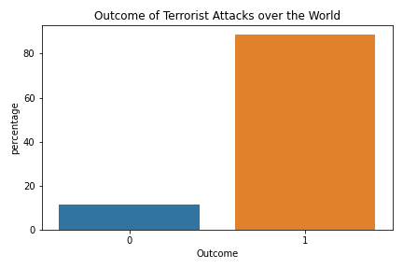
Success Rate of Terrorist Attacks
Of all the 181691 attacks 89% were successful, while 11% was unsuccessful.

Slide 28
06
Conclusion
Summarizing Key Findings and Implications

Slide 29
Conclusion
The analysis of global terrorist incidents reveals several key insights into the patterns and dynamics of terrorist attacks over the years. These insights shed light on the factors contributing to the rise and decline of terrorism-related killings and provide valuable information for understanding the nature of terrorist incidents.
1. Rise and Decline of Terrorism-Related Killings:
The peak in the number of killings by terrorist attacks occurred in the year 2014, followed by a subsequent decrease. This pattern can be attributed to multiple factors:
Rise of ISIS: The year 2014 witnessed the significant rise of the Islamic State of Iraq and Syria (ISIS), leading to numerous large-scale attacks worldwide.
Syrian Civil War: The intensification of the Syrian Civil War and its global impact contributed to increased terrorism and violence.

Slide 30
Conclusion
2. Regional Patterns:
The Middle East & North African region and South Asian region have consistently faced a higher number of killings compared to other regions, indicating ongoing instability.
3. Attack Types and Targets:
The combination of armed assaults and bombings/explosions accounts for a significant portion, specifically 77%, of the fatalities resulting from these attacks. This high fatality rate underscores the recurring use of these tactics in terrorist activities, highlighting the profound threat posed by weapons and explosives on a global scale.
The majority of deaths occurred when the targets were citizens of the country, specific properties, military personnel, or the police.

Slide 31
Conclusion
4. Terrorist Groups:
Unknown groups account for the highest percentage of killings at 44.3%, followed by the ISIL at 15.3% and Taliban at 11.6%.
5. Weapons Used:
Explosives are the primary weapons used, especially in the Middle East & North African and South Asian regions.
6. Regional Differences:
Significant differences exist in average fatalities between the Middle East & North Africa region and Sub-Saharan Africa. Attacks by unknown groups are associated with significantly higher fatalities compared to attacks by known groups.

Slide 32
Conclusion
7. Attack Types and Total Killings:
There is no significant difference in total killings between bombing and armed assault attacks.
In conclusion, the rise and subsequent decline in terrorism-related killings are the result of complex interactions among geopolitical events, global responses, and counterterrorism efforts. The insights drawn from this analysis provide a deeper understanding of the evolving nature of terrorist incidents, which can inform strategies for prevention, response, and international cooperation in countering terrorism.

Slide 33
07
References
Citations and Sources Used in the Report

Slide 34
References
Berger, J. M., & Strathearn, B. (2013). International Centre for Study of Radicalisation. [Review of International Centre for Study of Radicalisation].
Crenshaw, M. (2017). Transnational jihadism and civil wars. Daedalus, 146(4), 59-70.
Gartenstein-Ross, D., & Moreng, B. (2016). The Islamic State’s Global Propaganda Strategy. The International Centre for Counter-Terrorism - the Hague.
GTD (Global Terrorism Database). (2021). Global Terrorism Database report 1970-2017. https://www.start.umd.edu/gtd
Jones, S. G. & Libicki, M. C. (2008). How terrorist groups end: Lessons for countering al Qa'ida. Rand Corporation.
Li, Q. & Schaub, D. (2004). Economic globalization and transnational terrorism. Journal of Conflict Resolution, 48(2), 230-258.
Piazza, J. A. (2008). International Studies Quarterly, 52(3).

